Slide 1
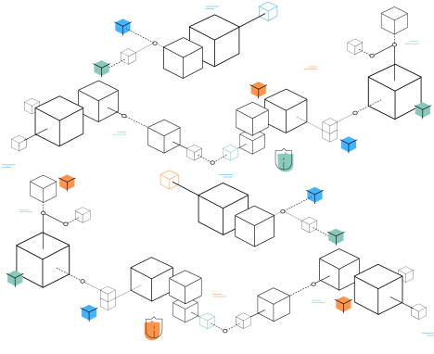
BLOCKCHAIN PASSBOOK

Slide 2
Blockchain for whom: Genesis
Block Number | 0
Timestamp | 1705731165.2163641
transactions | No Transactions First Genesis Block
Gas fee | 0.1
Nonce | 100
Current hash | 7433b02c2f1d50b35fff5c48a5ba7815c1cf5b0ae274cac1f2048dee218ef194
Previous Hash | No previous Hash. Since this is the first block

Slide 3
Blockchain for whom: Teacher Zara
Block Number | 1
Timestamp | 1705731165.3147333
Gas fee | 0.1
Nonce | 34348
Current hash | ca15f535b8700fb8be434fe2da7d5f1bad9cd3db5603c51b0ce92d223ebf9070
Previous Hash | 7433b02c2f1d50b35fff5c48a5ba7815c1cf5b0ae274cac1f2048dee218ef194

Slide 4
Blockchain for whom: Friend & Family Member
Block Number | 2
Timestamp | 1705731165.6874862
Gas fee | 0.1
Nonce | 134796
Current hash | bf0819f1111c068b08f000600931027dbefe39ce7f8907ab376ebdfd9f90fa75
Previous Hash | ca15f535b8700fb8be434fe2da7d5f1bad9cd3db5603c51b0ce92d223ebf9070

Slide 5
Blockchain Learnings:
I have learned about creating, verifying and validating of blocks and transactions in a blockchain
Created by: Your Name

